Slide 1




NEXT GEN EMPLOYABILITY PROGRAM
Creating a future-ready workforce
Team Members
College Name
Student Name: MUBEENA E M
Student ID: au513521104028
Annai Mira college of engineering and technology

Slide 2

CAPSTONE PROJECT SHOWCASE
Project Title
Building Bus Reservation System using Python and Django
Abstract | Problem Statement | Project Overview | Proposed Solution | Technology Used | Modelling & Results | Conclusion

Slide 3
Abstract
The Bus Reservation System is a comprehensive web application designed to simplify the process of booking bus tickets for users and efficiently managing bus schedules and bookings for administrators. Developed using Python and Django framework, the system offers a user-friendly interface, robust authentication, secure payment integration, and advanced booking management capabilities.
Key features include:
User Registration and Authentication: Secure user registration and login functionality to ensure data privacy and access control.
Route Search and Booking: Users can easily search for bus routes, select seats, and complete bookings in a few simple steps.
Real-time Seat Availability: Users can check seat availability in real time to make informed booking decisions.
Payment Integration: Secure payment processing ensures smooth and reliable transactions.
Booking Management: Users can view and manage their bookings, while administrators have access to a comprehensive dashboard for managing routes, schedules, and bookings.
Reporting and Analytics: Generate reports on booking statistics, revenues, and popular routes for informed decision-making.
Future Enhancements: Potential future enhancements include real-time bus tracking, multi-language support, dynamic pricing, and social media integration.

Slide 4
Problem Statement
The current process of booking bus tickets is often cumbersome and inefficient, both for users and administrators. Users face challenges in searching for routes, checking seat availability, and completing bookings, while administrators struggle to manage schedules, handle bookings, and generate reports effectively. This inefficiency results in frustration for users and operational challenges for bus companies.
Therefore, the aim of this project is to develop a Bus Reservation System that addresses these challenges and provides a seamless and user-friendly experience for both users and administrators. The system should streamline the process of searching for routes, booking tickets, managing schedules, and generating reports, ultimately improving efficiency and customer satisfaction.
Key Objectives:
Develop a user-friendly interface for searching routes, selecting seats, and completing bookings.
Implement secure authentication and payment processing to ensure data privacy and transaction security.
Design a robust backend system for managing bus routes, schedules, bookings, and generating reports.
Enhance user experience with features such as real-time seat availability and booking management.
Provide administrators with a comprehensive dashboard for managing routes, schedules, bookings, and analyzing data.

Slide 5
Project Overview
User Registration and Authentication:
Secure registration and login functionality for users to access the system.
Route Search and Booking:
Users can search for bus routes based on origin, destination, and travel date.
Real-time seat availability and selection feature.
Easy booking process with secure payment integration.
Booking Management:
Users can view and manage their bookings, including canceling or modifying existing bookings.
Administrators have access to a comprehensive dashboard for managing bookings, routes, and schedules.
Reporting and Analytics:
Generate reports on booking statistics, revenues, and popular routes for strategic decision-making.
Security and Privacy:
Implementation of robust security measures to protect user data and ensure transaction security.

Slide 6
Technology Stack:
Backend: Python with Django framework
Frontend: HTML, CSS, JavaScript
Database: PostgreSQL
Payment Integration: Secure payment gateway API
Email Service: Integration with an email service provider for automated notifications.
Implementation Approach:
Database Design: Define database schema for bus routes, schedules, bookings, and users.
User Interface: Develop a user-friendly interface for searching routes, selecting seats, and completing bookings.
Backend Logic: Implement server-side logic using Python and Django to handle user requests and data processing.
Payment Integration: Integrate with a secure payment gateway API for handling transactions.
Security Measures: Implement best practices for data security, authentication, and authorization.
Testing and Quality Assurance: Conduct thorough testing to ensure system functionality and reliability.
Deployment: Deploy the application on a reliable web server and perform regular maintenance.

Slide 7
Proposed Solution
Introduction: The Bus Reservation System is a sophisticated web application developed utilizing Python and the Django framework. Its primary objective is to facilitate user-friendly bus ticket bookings while providing administrators with efficient tools to manage schedules and reservations. This solution aims to streamline the booking process for users and optimize operational efficiency for administrators.
Key Features:
User Registration and Authentication:
Robust user registration and authentication mechanisms ensure data security and access control.
Route Search and Booking:
Intuitive interface enables users to effortlessly search for bus routes based on origin, destination, and travel dates.
Real-time seat availability display empowers users to select seats conveniently.
Seamless booking process integrated with secure payment gateways guarantees safe transactions.
Booking Management:
User dashboard offers comprehensive booking management features, including viewing booking history and modifying reservations.
Admin dashboard facilitates efficient management of bus routes, schedules, bookings, and report generation.
Reporting and Analytics:
Advanced reporting tools generate insightful analytics on booking statistics, revenues, and route popularity for strategic decision-making.
Security and Compliance:
Implementation of industry-standard security protocols ensures compliance with data privacy regulations and protects user information.
.

Slide 8


Technology Used
Front-end
Back-end
Source :

Slide 9
Modelling & Results
Database Schema Design:
Bus Route: Fields for origin, destination, distance, fare, etc.
Bus Schedule: Fields for departure time, arrival time, available seats, bus type, etc.
Relationships:
Bus Route has many Bus Schedules.
Bus Schedule belongs to a Bus Route and has many Bookings.
Booking belongs to a Bus Schedule and a User.
Views and Templates:
Implement views to handle user authentication, route search, seat selection, booking process, and admin dashboard.
Develop templates for rendering HTML pages with dynamic data from the backend.
Forms and Validation:
Create forms for user registration, login, booking details, etc., with validation for data integrity.
Implement client-side and server-side validation to ensure data correctness.
Payment Integration:
Integrate with a payment gateway API (e.g., Stripe) to handle payment processing securely.
Implement callbacks to update booking status based on payment success or failure.
Email Notifications:
Configure email templates for booking confirmations, cancellations, and reminders.
Integrate with an email service provider (e.g., SendGrid) to send automated notifications.
Security Measures:
Implement CSRF protection, input validation, and proper error handling to prevent common web vulnerabilities.
Use HTTPS protocol for secure communication and store sensitive data securely.

Slide 10
RESULTS
Bus Search Results:
Users can search for buses based on criteria such as source, destination, date, and time.
Results display available buses matching the search criteria, including details like bus number, departure time, and price.
Seat Availability:
Users can view seat availability for a selected bus and choose their preferred seat.
Results show a graphical representation of the bus layout with available and booked seats.
Booking Confirmation:
After selecting seats and providing passenger details, users can confirm their booking.
Results display a confirmation message with the reservation details and a booking reference number.
Reservation Management:
Users can view their reservations and make modifications or cancellations if allowed.
Results show a list of current reservations with options to edit or cancel.
Payment Confirmation:
Users can make payments for their reservations securely through integrated payment gateways.
Results display a payment confirmation message and email receipt upon successful payment.
Admin Dashboard:
Administrators can manage buses, routes, seat availability, and reservations.
Results show an administrative interface with options to add, edit, or delete buses, routes, and reservations.
Reporting and Analytics:
Admins can generate reports on booking statistics, revenue, and occupancy rates.
Results provide insights into business performance and help in making data-driven decisions.

Slide 11
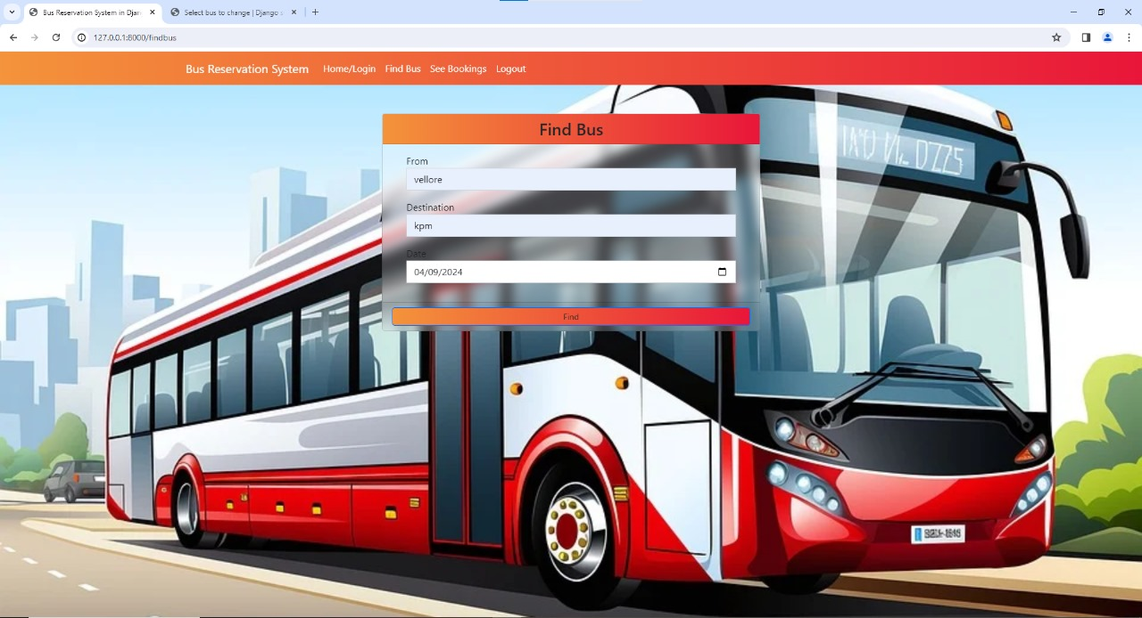
Homepage
Search Form:
Provide a search form where users can input their travel details such as source, destination, date, and optionally, the number of passengers.
2. Popular Routes:
Display a list of popular routes or destinations. This could be based on historical booking data or predefined routes.
3. Featured Buses:
Highlight a few buses or offers to attract user attention. You can showcase buses with special amenities, discounts, or new routes.
4. Navigation Menu:
Include a navigation menu that allows users to easily access different sections of the website, such as login/register, about us, contact, and FAQ.
5. Booking Offers:
Promote any ongoing booking offers or discounts to incentivize users to make reservations.
6. Testimonials:
Display testimonials from satisfied customers to build trust and credibility.
7. Contact Information:
Provide contact information or a contact form for users to reach out for assistance or inquiries.
8. Footer:
Include links to important pages, terms of service, privacy policy, and social media profiles in the footer section.

Slide 12
About-Us-Page
Welcome to our project for building a Bus Reservation System using Python and Django! This project is the culmination of our efforts as students studying.
Who We Are
We are a dedicated team of students passionate about software development and eager to apply our skills to real-world projects.
Our Mission
Our mission is to create a robust and user-friendly Bus Reservation System that simplifies the process of booking bus tickets for users while showcasing our expertise in Python and Django development.
Our Journey
This project began as an assignment in our class. Over the course of the semester, we embarked on a journey of exploration and learning, diving deep into Python and Django to design and implement the features of our Bus Reservation System.
Contact Us
We welcome any questions, feedback, or inquiries about our project. Please don't hesitate to reach out to us at [Contact Email] with any comments or suggestions.
Social Media
Follow us on social media to stay updated on our project progress, announcements, and insights into our development process:
Acknowledgments
We would like to express our gratitude to our instructor for their guidance and support throughout this project. Their expertise and encouragement have been invaluable to our success.
Footer
Links to important pages (Home, Search Routes, Sign In/Sign Up, etc.).
Privacy Policy, Terms of Service, and other relevant information.

Slide 13
Service-Page
1. Search and Book Bus Tickets
Easily search for bus routes based on your origin, destination, and travel date. Select your preferred seats and complete the booking process in just a few simple steps.
2. Real-Time Seat Availability
Check real-time seat availability for each bus schedule to ensure you can secure your preferred seats before booking.
3. Secure Payment Processing
Enjoy peace of mind with our secure payment processing system. We use industry-standard encryption to protect your payment information during transactions.
4. User-Friendly Interface
Our intuitive user interface makes it easy for users of all levels to navigate the system, search for routes, and book tickets effortlessly.
5. Booking Management
View and manage your bookings conveniently through your user account. Cancel or modify bookings as needed, and receive email notifications for updates.
6. Admin Dashboard
For administrators, our system offers a comprehensive admin dashboard for managing bus routes, schedules, bookings, and generating reports.
7. Reporting and Analytics
Gain insights into booking trends, revenues, and popular routes with our reporting and analytics tools. Make data-driven decisions to optimize your bus reservation operations.
8. Responsive Design
Our system is designed to work seamlessly across various devices, including desktops, laptops, tablets, and smartphones, ensuring a consistent user experience.
9. Customer Support
Have questions or need assistance? Our dedicated customer support team is here to help. Contact us via email or phone for prompt assistance with your inquiries.

Slide 14
Departments-Page
Development Team
The Development Team is responsible for designing, implementing, and maintaining the core functionality of the Bus Reservation System. This team works with Python, Django, HTML, CSS, and JavaScript to create a seamless user experience and ensure the system's reliability and performance.
Design Team
The Design Team is tasked with creating the visual elements and user interface components of the Bus Reservation System. This team focuses on user experience (UX) design, interface design, and branding to ensure the system is intuitive, visually appealing, and consistent with the project's goals.
Quality Assurance (QA) Team
The QA Team plays a crucial role in ensuring the quality and reliability of the Bus Reservation System. This team conducts thorough testing, including functional testing, usability testing, and performance testing, to identify and address any issues or bugs before the system is deployed to users.
Project Management Team
The Project Management Team oversees the planning, coordination, and execution of the Bus Reservation System project. This team is responsible for setting project goals, managing timelines and resources, and facilitating communication and collaboration among team members to ensure the project's success.
Support Team
The Support Team provides ongoing assistance and support to users of the Bus Reservation System. This team handles user inquiries, troubleshoots issues, and provides guidance and training as needed to ensure a positive user experience and satisfaction with the system.
Join Our Team
Interested in joining one of our departments and contributing to the Bus Reservation System project? Visit our Careers page to learn about current job openings and opportunities to become part of our dynamic team.

Slide 15
Blog-Page
Travel Tips and Insights
"Top Destinations for Your Next Bus Trip"
Explore popular travel destinations and discover exciting bus routes for your next adventure. This article highlights scenic routes, cultural landmarks, and hidden gems worth exploring.
"Tips for a Stress-Free Bus Travel Experience"
Get practical tips and advice for a smooth and enjoyable bus travel experience. From packing essentials to planning your itinerary, this article covers everything you need to know for a stress-free journey.
Project Updates
"Bus Reservation System Milestone: Launching Beta Version"
We're excited to announce the launch of the beta version of our Bus Reservation System! Learn about the key features, improvements, and feedback we've received from early users.
Stay Connected
Don't miss out on our latest updates, articles, and insights. Subscribe to our newsletter to receive regular updates straight to your inbox.

Slide 16
Future Enhancements:
Dynamic Pricing: Implement dynamic pricing based on factors such as demand, time of day, or special events. This can help optimize bus utilization and revenue generation.
Feedback and Ratings: Allow users to provide feedback and ratings for their bus travel experience. This can help improve service quality and provide valuable insights for future enhancements.
Analytics and Reporting: Implement analytics and reporting features to track key metrics such as reservation volume, bus occupancy rates, revenue, and customer satisfaction. This data can be used to identify trends, make informed business decisions, and optimize operations.
Geolocation Integration: Integrate geolocation services to provide users with information about nearby buildings, bus stops, and routes. This can enhance the user experience and make it easier for users to find and reserve buses.
Accessibility: Ensure that the reservation system is accessible to users with disabilities by following web accessibility standards (e.g., WCAG). This involves designing the user interface with proper contrast, providing alternative text for images, and ensuring keyboard navigation support.

Slide 17
Conclusion
The building bus reservation system developed using Python and Django provides a robust platform for managing bus reservations efficiently. With its current features and potential future enhancements, the system offers a convenient solution for users to book bus seats and administrators to manage bus operations effectively.
Through the use of Django's powerful framework, the system ensures scalability, security, and maintainability. The implementation of models for buildings, buses, and reservations, along with corresponding views and templates, forms the foundation of the system, enabling users to view available buses and make reservations seamlessly.
Furthermore, future enhancements such as user authentication, payment integration, real-time updates, and mobile app development promise to elevate the system's functionality and user experience to new heights. These enhancements not only address user needs but also contribute to the system's sustainability and adaptability in a dynamic environment.
In essence, the building bus reservation system serves as a testament to the capabilities of Python and Django in developing sophisticated web applications. By continuously refining and expanding its features, the system remains poised to meet the evolving needs of its users and stakeholders, providing a reliable and efficient solution for managing bus reservations.

Slide 18
Thank You!
Notes:
Thank You !!

